Slide 1


Slide 2
1
Introduction
2
Techniques for Descriptive Analysis
CONTENTS
3
Types of Descriptive Analysis
4
How to Conduct a Descriptive Analysis

Slide 3
Introduction
The conversion of raw data into a form that will make it easy to understand & interpret, ie., rearranging, ordering, and manipulating data to provide insightful information about the provided data.
Descriptive Analysis is the type of analysis of data that helps describe, show or summarize data points in a constructive way such that patterns might emerge that fulfill every condition of the data.
01
.

Slide 4
What is Descriptive Analysis?
Descriptive analysis is a sort of data research that aids in describing, demonstrating, or helpfully summarizing data points so those patterns may develop that satisfy all of the conditions of the data.
It is the technique of identifying patterns and links by utilizing recent and historical data. Because it identifies patterns and associations without going any further, it is frequently referred to as the most basic data analysis.
.

Slide 5
Techniques for Descriptive Analysis
1.Descriptive techniques often include constructing tables of quantiles and means, methods of dispersion such as variance or standard deviation, and cross-tabulations or "crosstabs" that can be used to carry out many disparate hypotheses.
2.Measures like segregation, discrimination, and inequality are studied using specialised descriptive techniques. Discrimination is measured with the help of audit studies or decomposition methods.
.

Slide 6
3. A table of means by subgroup is used to show important differences across subgroups, which mostly results in inference and conclusions being made.
4. A crosstab or two-way tabulation is supposed to show the proportions of components with unique values for each of two variables available, or cell proportions.
.

Slide 7
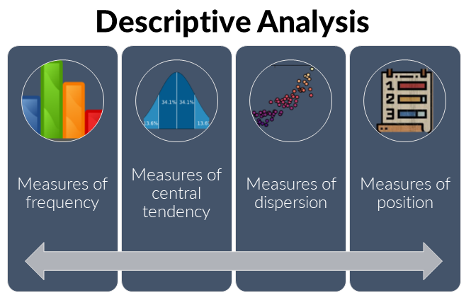

Slide 8
Measures of Frequency
In descriptive analysis, it’s essential to know how frequently a certain event or response is likely to occur.
This is the prime purpose of measures of frequency to make like a count or percent.

Slide 9
Measures of Central Tendency
In descriptive analysis, it’s also important to find out the Central (or average) Tendency or response.
Central tendency is measured with the use of three averages — mean, median, and mode.

Slide 10
Measures of Dispersion
Sometimes, it is important to know how data is divided across a range. To elaborate this, consider the average weight in a sample of two people. If both individuals are 60 kilos, the average weight will be 60 kg. However, if one individual is 50 kg and the other is 70 kg, the average weight is still 60 kg.
Measures of dispersion like range or standard deviation can be employed to measure this kind of distribution.

Slide 11
Measures of Position
Descriptive analysis also involves identifying the position of a single value or its response in relation to others.
Measures like percentiles and quartiles become very useful in this area of expertise.

Slide 12
How to Conduct a Descriptive Analysis?
Step 1: Data Collection
Step 2: Data Preparation
Step 3: Apply Methods
Step 4: Summary Statistics and Visualization

Slide 13
Step 1: Data Collection
Before conducting any analysis, you must first collect relevant data. This process involves identifying data sources, selecting appropriate data-collecting methods, and verifying that the data acquired accurately represents the population or topic of interest.
Step 2: Data Preparation
Data Cleaning
Data Transformation
Data Reduction

Slide 14
Step 3: Apply Methods
Frequency Distribution Analysis
Measures of Central Tendency
Measures of Dispersion
Measures of Position
Step 4: Summary Statistics and Visualization
Summary Statistics
Data Visualization

Slide 15
THANK YOU

